Slide 1
Representing Data
Programming at the Hardware/Software Interface

Slide 2

This work is licensed under a Creative Commons Attribution 4.0 International License. This work is ©2018-21 Christopher A. Bohn, bohn@unl.edu.
You are free to:
Share — copy and redistribute the material in any medium or format
Adapt — remix, transform, and build upon the material for any purpose, even commercially
Under the following terms:
Attribution — You must give appropriate credit, provide a link to the license, and indicate if changes were made. You may do so in any reasonable manner, but not in any way that suggests the licensor endorses you or your use.
No additional restrictions — You may not apply legal terms or technological measures that legally restrict others from doing anything the license permits.
Slide by Bohn
These lecture slides are meant to enhance your use of the Programming at the Hardware/Software Interface textbook. If you have not adopted this publication for your course, please consider doing so.

Slide 3
Number Bases

Slide 4
Choosing a number base
What number base is obvious? Why?
Slide by Bohn
Notes:
Most students will probably answer base 2, but that’s really a hindsight-driven statement. Nonetheless, go with it: what is “obvious” about binary numbers?
But even if they answer base 10, have them explain why that’s obvious.
And if they answer something else, I’m sure there’ll be a good discussion.

Slide 5
Choosing a number base
Base 10: 0 1 2 3 4 5 6 7 8 9
Human “standard” number base – probably because we have 10 fingers
Digit (noun): a finger or toe
Digit (noun): a numeral when used to form part of a number
Slide by Bohn

Slide 6
Choosing a number base
Base 10 [0 1 2 3 4 5 6 7 8 9]
Human-standard number base
Digit = Finger
Digit = each numeral in a number representation
Even carries through in scientific notation
6.8588 X 10⁴
Implementing Electronically
Hard to store
ENIAC (First electronic computer) used 10 vacuum tubes / digit
Hard to transmit
Need high precision to encode 10 signal levels on single wire
Messy to implement digital logic functions
Addition, multiplication, etc.
Slide by Bohn

Slide 7
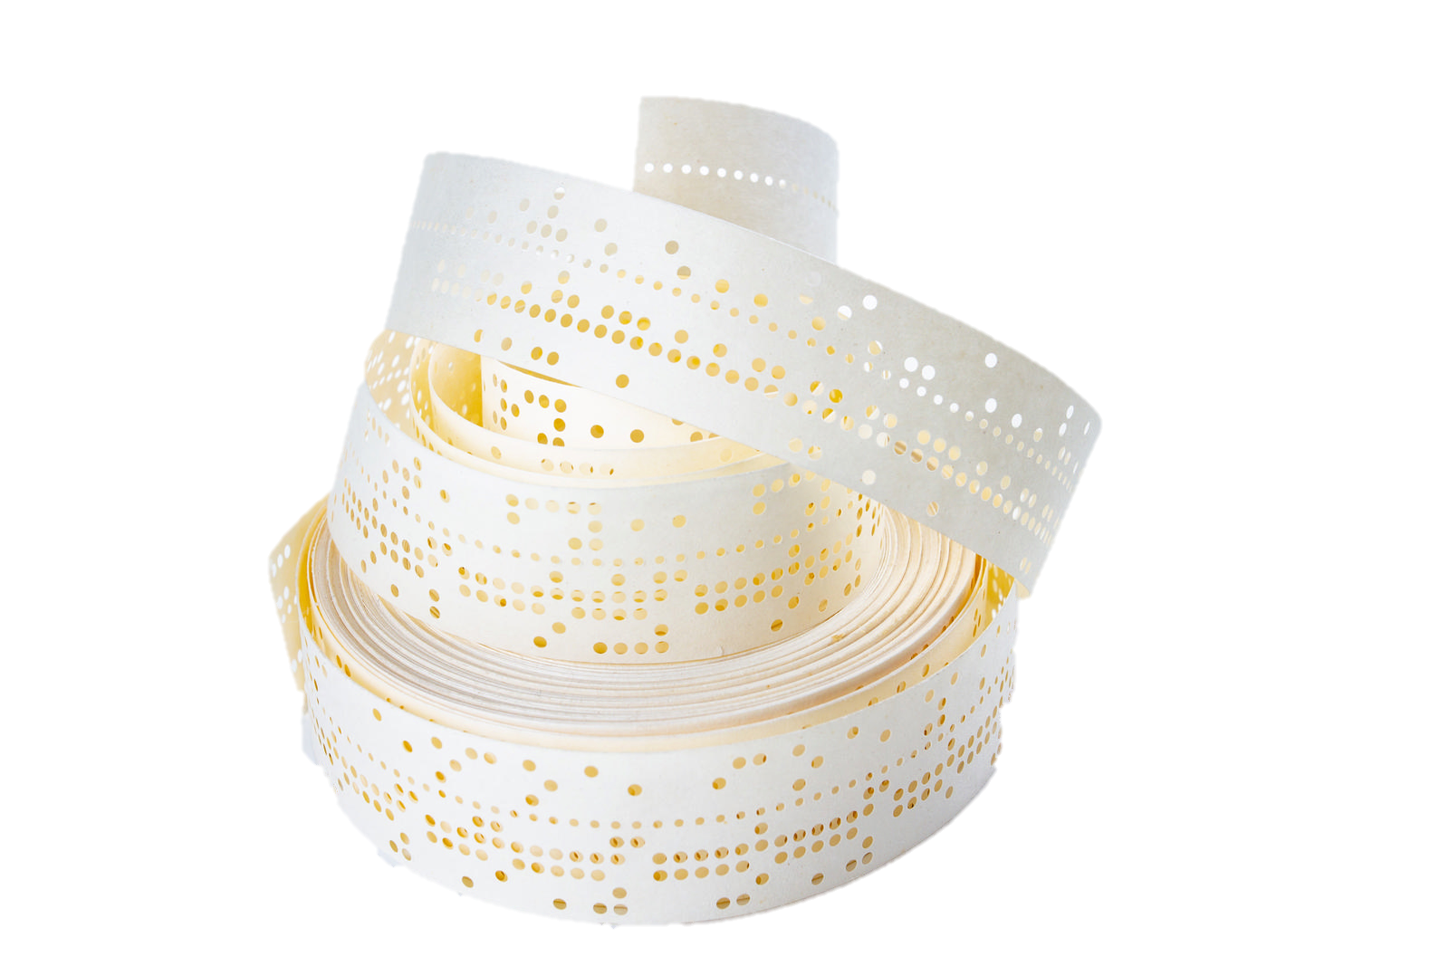
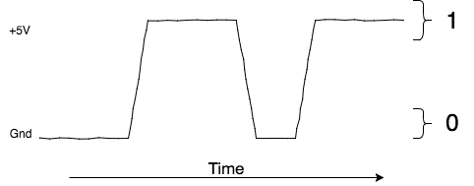
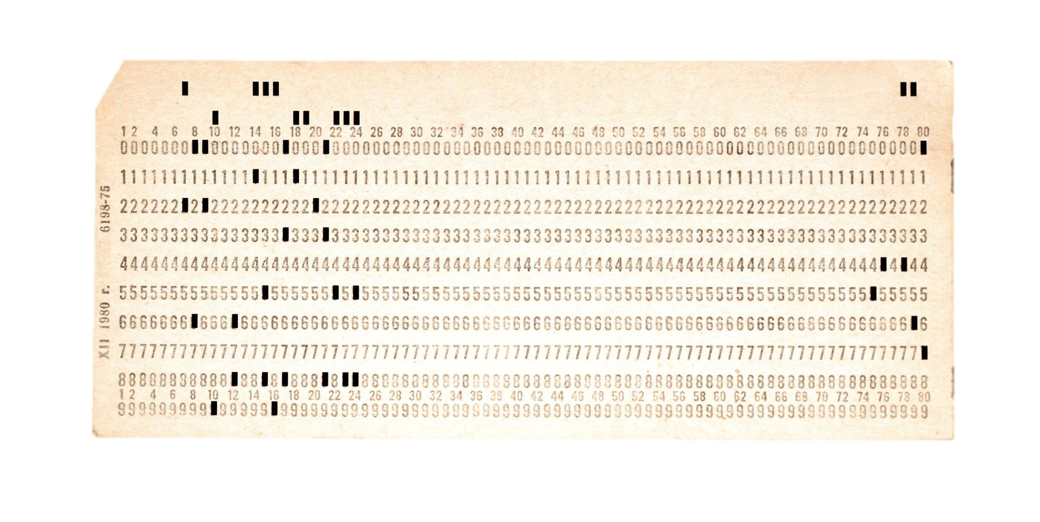

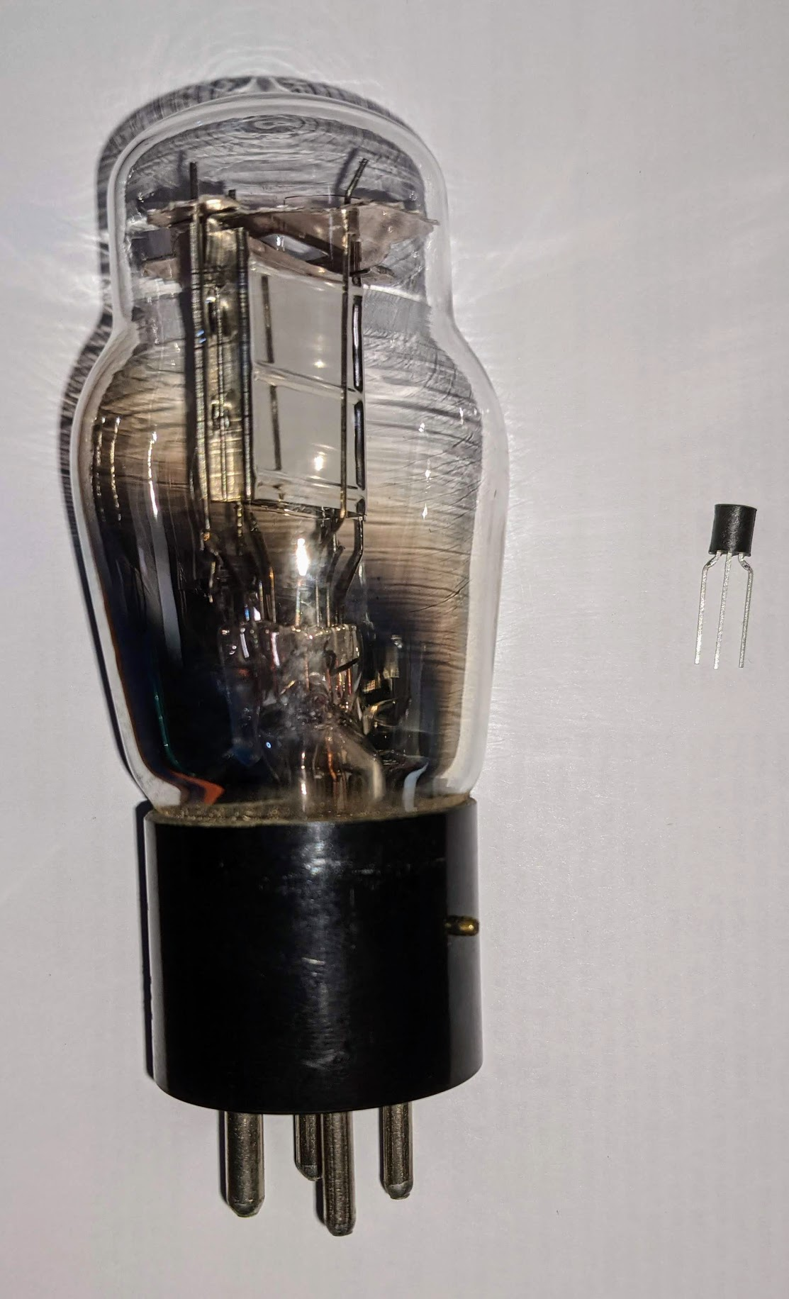
Choosing a number base
Base 2 [0 1]
“Binary Digit”
Easy to store
Punch cards / punch tape
Position of switch
Voltage amplitude
Transmission: Binary Frequency Shift Keying
Downside
Not human-readable
GCC allows binary representation with “0b”
10011101₂ can be written as 0b10011101 (becomes unwieldy with more bits)
Punch card / punch tape ©Shutterstock.com
Vacuum tube / transistor photo by Bohn
FSK of “Hello World,” prepared by Bohn
Slide by Bohn

Slide 8
Choosing a number base
Binary Coded Decimal (BCD)
Uses four bits to represent decimal values
Easy conversion to human-readable form
Wiring processors to perform math just as convoluted as ENIAC
Slide by Bohn

Slide 9
Choosing a number base
Hex | Binary | Decimal
0 | 0000 | 0
1 | 0001 | 1
2 | 0010 | 2
3 | 0011 | 3
4 | 0100 | 4
5 | 0101 | 5
6 | 0110 | 6
7 | 0111 | 7
8 | 1000 | 8
9 | 1001 | 9
A | 1010 | 10
B | 1011 | 11
C | 1100 | 12
D | 1101 | 13
E | 1110 | 14
F | 1111 | 15
Base 16 [0 1 2 3 4 5 6 7 8 9 A B C D E F]
Hexadecimal, or “hex”
A more-compact representation of Base 2
(Slightly) more human-readable than binary
Each hex digit corresponds to four bits
Exactly two hex digits needed to represent a byte
In C, indicate hex representation with “0x”
FA1D37B₁₆ would be written 0xFA1D37B (or 0xfa1d37b)
Slide by Bohn

Slide 10
Radix Conversions: Binary to Hex, Hex to Binary
Hex | Binary | Decimal
0 | 0000 | 0
1 | 0001 | 1
2 | 0010 | 2
3 | 0011 | 3
4 | 0100 | 4
5 | 0101 | 5
6 | 0110 | 6
7 | 0111 | 7
8 | 1000 | 8
9 | 1001 | 9
A | 1010 | 10
B | 1011 | 11
C | 1100 | 12
D | 1101 | 13
E | 1110 | 14
F | 1111 | 15
Hexadecimal to Binary
Replace hex-digit with corresponding four bits
Binary to Hexadecimal
Separate bits into quartets starting with LSB
Replace each quartet with corresponding hex-digit
Slide by Bohn

Slide 11
Radix Conversions: Binary to Decimal
Hex | Binary | Decimal
0 | 0000 | 0
1 | 0001 | 1
2 | 0010 | 2
3 | 0011 | 3
4 | 0100 | 4
5 | 0101 | 5
6 | 0110 | 6
7 | 0111 | 7
8 | 1000 | 8
9 | 1001 | 9
A | 1010 | 10
B | 1011 | 11
C | 1100 | 12
D | 1101 | 13
E | 1110 | 14
F | 1111 | 15
Apply weighted sums
“Ones” place adds 0 or 1
“Twos” place adds 0 or 2
“Fours” place adds 0 or 4
“Eights” place adds 0 or 8
…
2^{i}s place adds 0 or 2^{i}
Slide by Bohn

Slide 12
Radix Conversions: Decimal to Binary (repeated division)
Hex | Binary | Decimal
0 | 0000 | 0
1 | 0001 | 1
2 | 0010 | 2
3 | 0011 | 3
4 | 0100 | 4
5 | 0101 | 5
6 | 0110 | 6
7 | 0111 | 7
8 | 1000 | 8
9 | 1001 | 9
A | 1010 | 10
B | 1011 | 11
C | 1100 | 12
D | 1101 | 13
E | 1110 | 14
F | 1111 | 15
Repeatedly divide by 2
Remainder of each division becomes a bit
Stop when quotient is 0
Slide by Bohn
1
1
0
1
0
0
1
0

Slide 13
Radix Conversions: Decimal to Binary (repeated subtraction)
Hex | Binary | Decimal
0 | 0000 | 0
1 | 0001 | 1
2 | 0010 | 2
3 | 0011 | 3
4 | 0100 | 4
5 | 0101 | 5
6 | 0110 | 6
7 | 0111 | 7
8 | 1000 | 8
9 | 1001 | 9
A | 1010 | 10
B | 1011 | 11
C | 1100 | 12
D | 1101 | 13
E | 1110 | 14
F | 1111 | 15
Repeatedly subtract by powers-of-two
Start with greatest power-of-two less than value
If power-of-two is less than working value, subtract, place a 1 bit, and go to next-smaller power-of-two
Otherwise, place a 0 bit and go to next-smaller power-of-two
1
1
0
1
0
0
1
0
Slide by Bohn

Slide 14
Radix Conversions: Decimal to Hex, Hex to Decimal
Hex | Binary | Decimal
0 | 0000 | 0
1 | 0001 | 1
2 | 0010 | 2
3 | 0011 | 3
4 | 0100 | 4
5 | 0101 | 5
6 | 0110 | 6
7 | 0111 | 7
8 | 1000 | 8
9 | 1001 | 9
A | 1010 | 10
B | 1011 | 11
C | 1100 | 12
D | 1101 | 13
E | 1110 | 14
F | 1111 | 15
Treat as chained conversion between decimal & binary and binary & hexadecimal
Slide by Bohn

Slide 15
From Bits to Bytes

Slide 16
Byte
8 bits
Binary: 0b00000000 to 0b11111111
Hexadecimal: 0x00 to 0xFF
As integer, 0₁₀ to 255₁₀ or -128₁₀ to 127₁₀
As character
128 ASCII characters plus 128 non-standard “Extended ASCII” characters, or
the first 128 UTF-8 characters (with most-significant bit fixed as 0)
Slide by Bohn

Slide 17
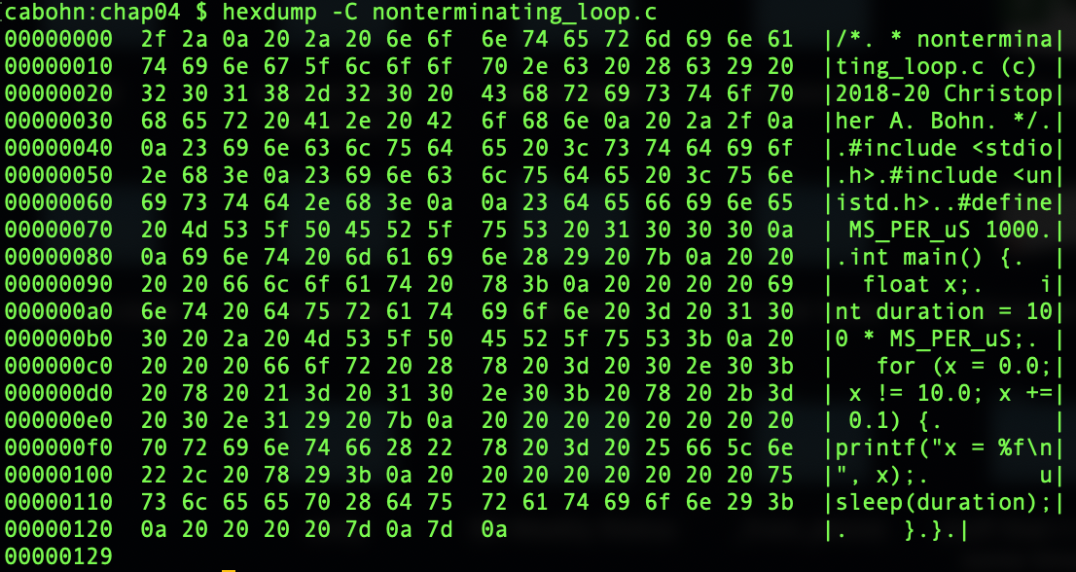
Hexdump nonTerminatingLoop.c source file
Slide by Bohn
Screenshot showing byte-level representation of plain-text file
Notes:
Note that each byte uses 2 hex digits (because each hex digit represents 4 bits)

Slide 18
Word
“Word size”
Size of data representations inside processor
Often nominal size of integer, memory address
Older machines
8-bit (1 byte) – Z80, 6502
16-bit (2 byte) – 8086, 68000
32-bit (4 byte) – Pentium, PowerPC
Typical modern microprocessor – 64-bit (8 byte)
Data types may be 1 word, multiple words, or a fraction of a word
(almost) Always an exact-integer number of bytes
Slide by Bohn
Notes:
Notable exception to “always an exact-integer”: Five 7-bit characters fit in 36-bit word of now-obsolete scientific computers
Notable exception to common assumption that data types are powers-of-two in size: x87’s 10-byte non-754-compliant FP type

Slide 19
Sizes of Data Types
Unsure?
Use C’s sizeof() operator
Want a guaranteed size?
Use int8_t, uint8_t, int16_t, uint16_t, etc.
C data type | 8-bit processor | 16-bit processor | 32-bit processor | 64-bit processor
char | 1 | 1 | 1 | 1
short | 2 | 2 | 2 | 2
int | 2 | 2 | 4 | 4
long | 4 | 4 | 4 | 8
long long | 8 | 8 | 8 | 8
float | 4 | 4 | 4 | 4
double | 4 | 8 | 8 | 8
long double | 4 | 8+ (10 on IA16) | 8-16 (10/12 on IA32) | 8-16 (10/16 on x86-64)
pointer | 2 | 2 | 4 | 8
Slide by Bohn
Notes:
Not too many 16-bit CPUs in use today.
MPUs tend to be 64 bit (e.g., modern Intel & AMD x86, ARM Cortex-A in Raspberry Pi 3-4, Apple M1), occasionally 32 bit (e.g., ARM Cortex-A in Raspberry Pi 1-2 & Terasic Altera DE10, Altera Nios II FPGA-based processor)
MCUs tend to be 8 bit (e.g., ATK in most Arduinos) or 32 bit (ARM Cortex-M in Arduino Due or Raspberry Pi Pico)
x86 long double is a 10-byte FP type that pre-dates FP standard (chap4) and doesn’t comply with it. For performance reasons (chap6), it gets padded-out to 12 bytes on IA32 and 16 bytes on x86-64.
uint8_t, etc, are defined in stdint.h, introduced in 1999 C standard. Rarely used except as bit vectors.

Slide 20
Multi-byte Values in Memory: Addresses
Address
0x103F
0x103E
0x103D
0x103C
0x103B
0x103A
0x1039
0x1038
0x1037
0x1036
0x1035
0x1034
0x1033
0x1032
0x1031
0x1030
1-byte values
2-byte values
4-byte values
8-byte values
Address specifies byte in memory
Multi-byte value’s address is the lowest address
Subsequent values’ addresses differ by
2 (16 bit type)
4 (32 bit type)
8 (64 bit type)
Addr= 0x103E
Addr= 0x103C
Addr= 0x1038
Addr= 0x103C
Addr= 0x103A
Addr= 0x1038
Addr= 0x1038
Addr= 0x1036
Addr= 0x1034
Addr= 0x1030
Slide by Bohn
Addr= 0x1034
Addr= 0x1032
Addr= 0x1030
Addr= 0x1030

Slide 21
Multi-byte Values in Memory: Byte Ordering
Unsure?
Use GCC’s __BYTE_ORDER__ pre-defined macro
Big Endian
Least significant byte has highest address
68k, PowerPC, SPARC, Internet, Java
Little Endian
Least significant byte has lowest address
x86, ARM, Alpha, RISC-V
Example
4-byte integer
i == 0x12345678
&i == 0x1034
Big
Endian
Little
Endian
Slide by Bohn
Address
0x1039
0x1038
0x1037
0x1036
0x1035
0x1034
0x1033
0x1032
67
12
56
34
34
56
12
78
Notes:
Strictly speaking, ARM is “bi-endian,” but it defaults to little endian.
Opportunity to point out value of using hexadecimal. In binary,
i = 0b00010010001101000101011001111000
Opportunity to remind students that &i creates a pointer to i. A pointer is a variable that contains a memory address – in this case, it contains the address of i. The pointer points to i.

Slide 22
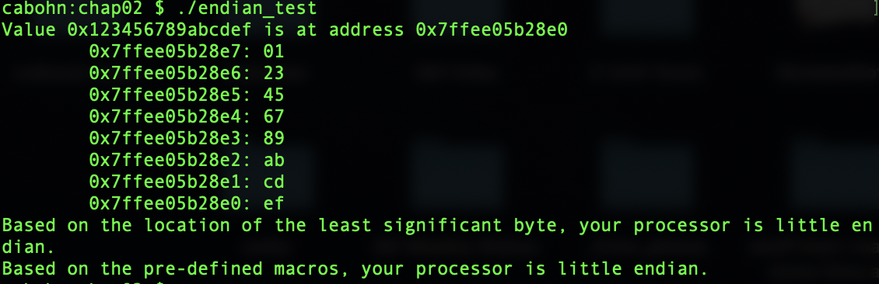
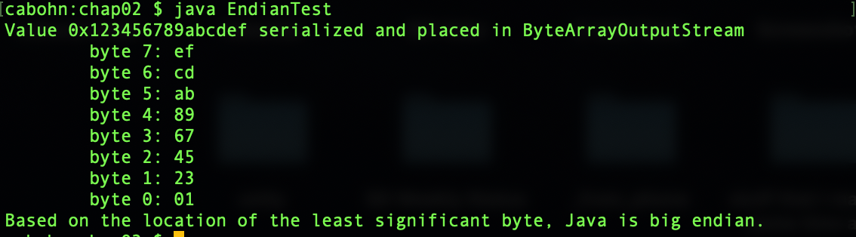
Multi-byte Values in Memory: Testing for Endianness
Intel Core i7
Java
Slide by Bohn
Screenshot of output from endian_test.c
Screenshot of output from EndianTest.java
Notes:
On left: LSB (0xEF) is at lowest address (0x7FFEE05B28E0)
On right: LSB is in the higher-order byte
Consider doing this as a live demo

Slide 23
Multi-byte Values in Memory: Byte-Reversed Listings
Disassembly
Reconstructs plain-text assembly code from binary object code
Example: objdump -d endian_test
Snippet: Address Machine Code Assembly Code 100000d8f: 89 d6 movl %edx, %esi 100000d91: 81 ee d2 04 00 00 subl $1234, %esi 100000d97: 89 45 bc movl %eax, -68(%rbp)
Slide by Bohn
Value 1234₁₀ = 0x4D2
Pad to 4 bytes 0x4D2 = 0x 00 00 04 D2
Appears reversed due to little-endianness

Slide 24
Pointers: Variables that hold memory addresses
Equivalently:
int i = 147456;
int *p = &i;
int *p; *p = 147456;
147456 = 2¹⁷ + 2¹⁴
= 0000 0000 0000 0010 0100 0000 0000 0000₂
= 0x00024000
Big
Endian
Little
Endian
Address
0x1039
0x1038
0x1037
0x1036
0x1035
0x1034
0x1033
0x1032
p
0x1034
00
00
👉
40
02
02
40
00
00
Slide by Bohn

Slide 25
Pointers: An Analogy
12344
12345
12346
Slide by Bohn
The envelope does not contain the house
12345 Sesame Street
The envelope contains the address of the house
Multiple envelopes can contain the same address
If the house changes, people holding each envelope see the change
12346 Sesame Street
12345 Sesame Street
Changing one envelope’s address does not affect other envelopes

Slide 26
C Strings
char s[] = "68588";
Array of ASCII characters
Terminated with ASCII NUL
'\0’
0x00
Byte ordering not relevant
A string is not a multibyte type
A string is an array of 1-byte char
A string is a pointer to a char
Big
Endian
Little
Endian
Address
0x103A
0x1039
0x1038
0x1037
0x1036
0x1035
0x1034
0x1033
00
00
38
38
s
0x1034
38
38
Slide by Bohn
👉
35
35
38
38
36
36
Notes:
See ASCII table for ASCII character mappings

Slide 27
Machine-Level Code Representation
Programs are byte sequences
Encode Program as Sequence of Instructions
Each instruction is a simple operation
Arithmetic operation
Read or write memory
Conditional branch
Instructions encoded as bytes
Different instruction set architectures interpret bytes differently
ARM, PowerPC (pre-2006 Mac) use 4 byte instructions
Reduced Instruction Set Computer (RISC)
x86 uses variable length instructions
Complex Instruction Set Computer (CISC)
Slide by Bohn

Slide 28
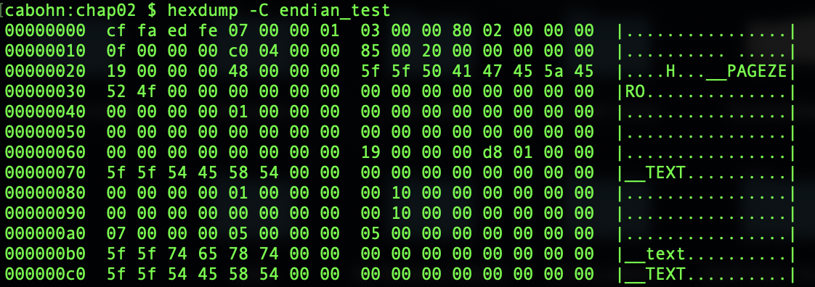
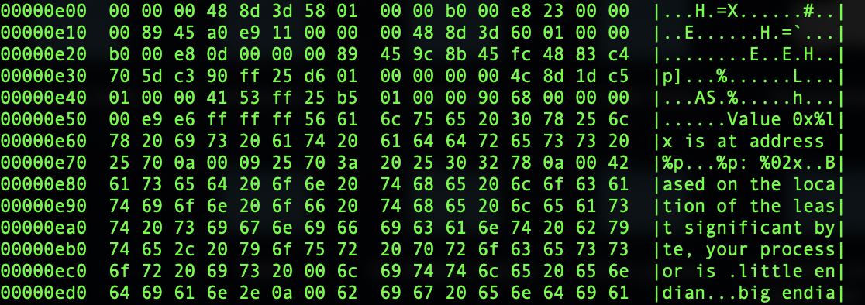
Hexdump loopIndexing executable file
Slide by Bohn

Slide 29
Instruction Set Architectures: Different Bytes for same C-level code
int add(int x, int y) { return x+y; }
Compile with gcc -Og …
x86 uses a 3-byte instruction and a 1-byte instruction
ARM uses two 4-byte instructions
X86-64 401136: 8d 04 37 lea (%rdi,%rsi,1),%eax 401139: c3 ret
ARM64 400620: 0b 01 00 00 add w0, w0, w1 400624: d6 5f 03 c0 ret
Slide by Bohn

Slide 30
Bit Operations

Slide 31
Bit Operations: Logical Operators vs Bitwise Operators
Logical Operators
Bitwise Operators
Operands are any integer type
False = 0
True = non-zero (operators return 1 for True)
AND a && b
OR a || b
NOT !a
Operators are any integer type
Treats operators as bit vectors
Applies operation to each bit position
AND a & b
OR a | b
NOT ~a
XOR a ^ b
Slide by Bohn
Notes:
My students take discrete math course before this course. If yours haven’t, you may want to cover these operators – though the logical operators should’ve also been covered in CS1.

Slide 32
Boolean and Integer Algebras
Boolean
Integer
Or (|) is the “sum” operation
And (&) is the “product” operation
Not (~) is the “complement” operation
Not additive inverse
0 is the identity for sum (x|0=x)
1 is the identity for product (x&1=x)
Addition (+) is the “sum” operation
Multiplication (*) is the “product” op
Subtraction (-) is the additive inverse
0 is the identity for sum (x+0=x)
1 is the identity for product (x*1=x)
Slide by Bohn

Slide 33
Boolean and Integer Algebras – similarities
Boolean
Integer
Commutativity
A|B = B|A
A&B = B&A
Associativity
(A|B)|C = A|(B|C)
(A&B)&C = A&(B&C)
Product distributes over sum
A&(B|C) = A&B | A&C
Sum and product identities
A|0 = A A&1 = A
Zero is product annihilator
A&0 = 0
Cancellation of negation
~(~A) = A
Commutativity
A+B = B+A
A*B = B*A
Associativity
(A+B)+C = A+(B+C)
(A*B)*C = A*(B*C)
Product distributes over sum
A*(B+C) = A*B + A*C
Sum and product identities
A+0 = A A*1 = A
Zero is product annihilator
A*0 = 0
Cancellation of negation
-(-A) = A
Slide by Bohn

Slide 34
Boolean and Integer Algebras – differences
Boolean
Integer
Sum distributes over product
A|(B&C) = (A|B) & (A|C)
Idempotency
A|A = A
A&A = A
Absorption
A|(A&B) = A
A&(A|B) = A
Laws of Complements
A|~A =1
A&~A = 0
No additive inverse
Sum doesn’t distribute over product
A+(B*C) ≠ (A+B) * (A+C)
No idempotency
A+A ≠ A
No absorption
A+(A*B) ≠ A
A*(A+B) ≠ A
Additive Inverse
A+ -A =0
No Law of Complements
Slide by Bohn

Slide 35
Boolean Algebra – derived operators
XOR (“exclusive or”)
A^B is 1 if only A is 1, or if only B is 1
A^B is 0 if both A and B are 1 or if, or if both are 0
A^B = A&~B | ~A&B
A^A = 0 A^~A = 1
A^0 = A A^1 = ~A
NAND, NOR, XNOR
“Not AND,” “Not OR,” “Not XOR”
Not used in C, found in logic gates
Slide by Bohn

Slide 36
Bit Operations: Bitwise Boolean Operators
0101 1010
0101 1010
0101 1010
& 1100 0011
| 1100 0011
^ 1100 0011
~ 1100 0011
0100 0010
1101 1011
1001 1001
0011 1100
uint8_t i = 0x37;
uint8_t j = 0x6C;
uint16_t k = 0x6C;
i & j ==
0x24
0011 0111
i | j ==
0x7F
~ 0110 1100
^ 0110 1100
& 0110 1100
Slide by Bohn
| 0110 1100
i ^ j ==
0x5B
1001 0011
0101 1011
0010 0100
0111 1111
~j ==
0x93
~ 0000 0000 0110 1100
~k ==
0xFF93
1111 1111 1001 0011

Slide 37
Bit Operations: Bit Shift Operators
0x5A << 3 = 0xD0
0x5A << 3
Left Shift x << y
Move x’s bits to the left by y positions
Fill with 0s on right
Truncate excess bits on left
Right Shift x >> y
Move x’s bits to the right by y positions
Truncate excess bits on right
Logical shift: fill with 0s on left
Arithmetic shift: duplicate leftmost bit
01011010000
0xA5 << 2 = 0x94
0xA5 << 2
10100101000
0x5A >> 3
0x5A >> 3 = 0x0D
00001011010
0x5Au >> 3
0x5Au >> 3 = 0x0Du
Slide by Bohn
00001011010
0xA5 >> 2
0xA5 >> 2 = 0xE9
11110100101
0xA5u >> 2
0xA5u >> 2 = 0x29u
00010100101

Slide 38
Bitmasks: Setting/Clearing a Bit
Clear every bit
Set every bit
Negate every bit
XXXX XXXX
XXXX XXXX
& 0000 0000
| 1111 1111
~ XXXX XXXX
0000 0000
1111 1111
YYYY YYYY
Clear bit2
Set bit5
Negate bit 6
XXXX XXXX
XXXX XXXX
XXXX XXXX
Slide by Bohn
& 1111 1011
| 0010 0000
^ 0100 0000
XXXX X0XX
XX1X XXXX
XYXX XXXX
foo & 0x4
foo & 0x20
foo ^ 0x40
Notes:
Bitmasks take advantage of Boolean dominance & absorption

Slide 39
Bitmasks: Testing a Bit
Is bit2 a 1?
Is bit5 a 0?
XXXX XXXX
~ XXXX XXXX
& 0000 0100
& 0010 0000
if (foo & 0x4)
if (~foo & 0x20)
if !(foo & 0x20)
Slide by Bohn
Notes:
Even though (~foo & 0x20) and !(foo & 0x20) produce different values when bit5 is a 0, they are logically equivalent.

Slide 40
Bitmasks: Parametric Bitmasks
All 0s except 1 at bit y
All 1s except 0 at bit y
0x1 << y
~(0x1 << y)
All 0s except 1s at bits y & z
All 1s except 0s at bits y & z
Slide by Bohn
(0x1 << y) | (0x1 << z)
~((0x1 << y) | (0x1 << z))
~(0x1 << y) & ~(0x1 << z)
Notes:
Last example makes use of DeMorgan’s Law

Slide 41

Key Ideas
Hexadecimal as shorthand for binary
Radix conversions: hexadecimal ⬄ binary ⬄ decimal
It’s all bits & bytes – interpret differently for different uses
Text, integer, address, machine code
Same uses can be different between machines
Word size, endianness, instruction set architecture
Bit operations
Bitwise AND, OR, XOR
Left-shift, Logical & Arithmetic Right-shift
Bitmasks
Slide by Bohn

